Slide 1
Module 1 Arrays

Slide 2
Arrays
Arrays are a collection of variables of the same data type. To declare an array, we can use the following:
int[] arr1; //declaration form #1
arr1 = new int[100]; //instantiation
int arr2[]; //declaration form #2
arr2 = new int[100]; //instantiation
int[] arr3 = new int[20]; //declaration and instatiation form #3
int arr4[] = new int[20]; //declaration and instatiation form #4

Slide 3
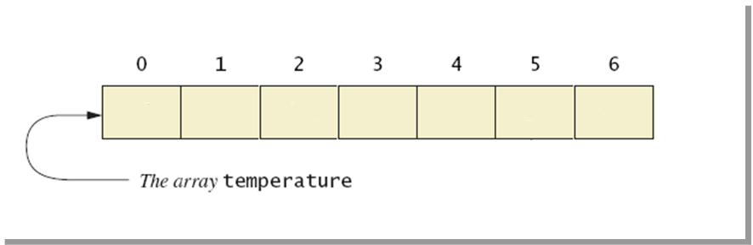
Visualizing Arrays
double[] temperature = new double[7];

Slide 4
Syntax
All array positions have to be of the same type. We cannot mix Strings, integers or doubles on the same array.
data_type[] array_name = new data_type[array_size];
data_type array_name[] = new data_type[array_size];
The array size needs to be a positive number greater than or equal to 0.

Slide 5
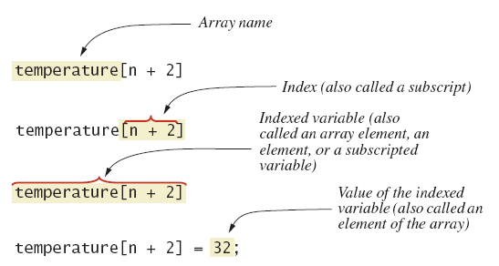
Nomenclature

Slide 6
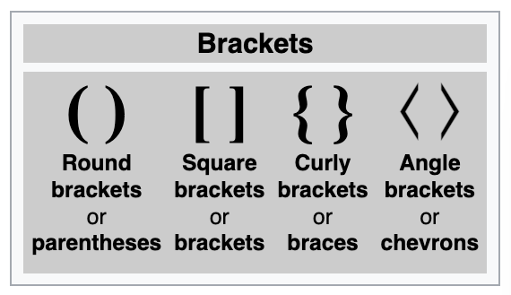
Brackets

Slide 7
Accessing array positions
To access the element of an array, we use square brackets [].
The first position of an array will always be index 0, and the last one will be array_name.length – 1.
double[] temperature = new double[7];
temperature[0] = 6.9; //first element index 0
temperature[1] = 30;
temperature[2] = 25.7;
temperature[3] = 26;
temperature[4] = 34;
temperature[5] = 31.5;
temperature[6] = 29; //last element index (temperature.length-1)
//temperature[temperature.length-1] = 29;

Slide 8
Accesing array positions
We can initialize an array in two ways:
Instantiating the array with the new operator, then filling each position.
Implicit instantiation with all array values
1
double[] temperature = new double[7];
temperature[0] = 6.9;
temperature[1] = 30;
temperature[2] = 25.7;
temperature[3] = 26;
temperature[4] = 34;
temperature[5] = 31.5;
temperature[6] = 29;
2
double[] temperature = {6.9, 30, 25.7, 26, 34, 31.5, 29};

Slide 9
Array size
To find the size of the array, we can use the length attribute.
The length of the array is a final attribute, it can never be changed changed.
double[] temperature = new double[7];
int len = temperature.length;
System.out.println(len); //prints 7
The last element of an array will always be length - 1.
temperature[temperature.length - 1] = 29;

Slide 10
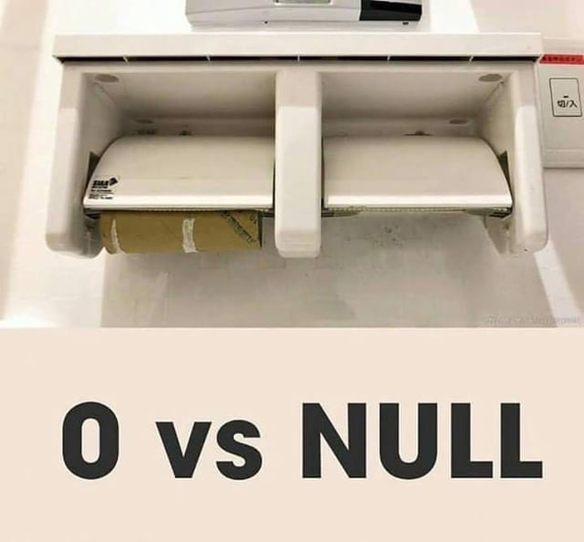
Array size
What would be the size of the following arrays?
double[] array1 = new double[10];
double[] array2 = new double[0];
double[] array3;
Answer:
array1 has a size of 10
array2 has a size of 0
array3 is null, it has no size

Slide 11
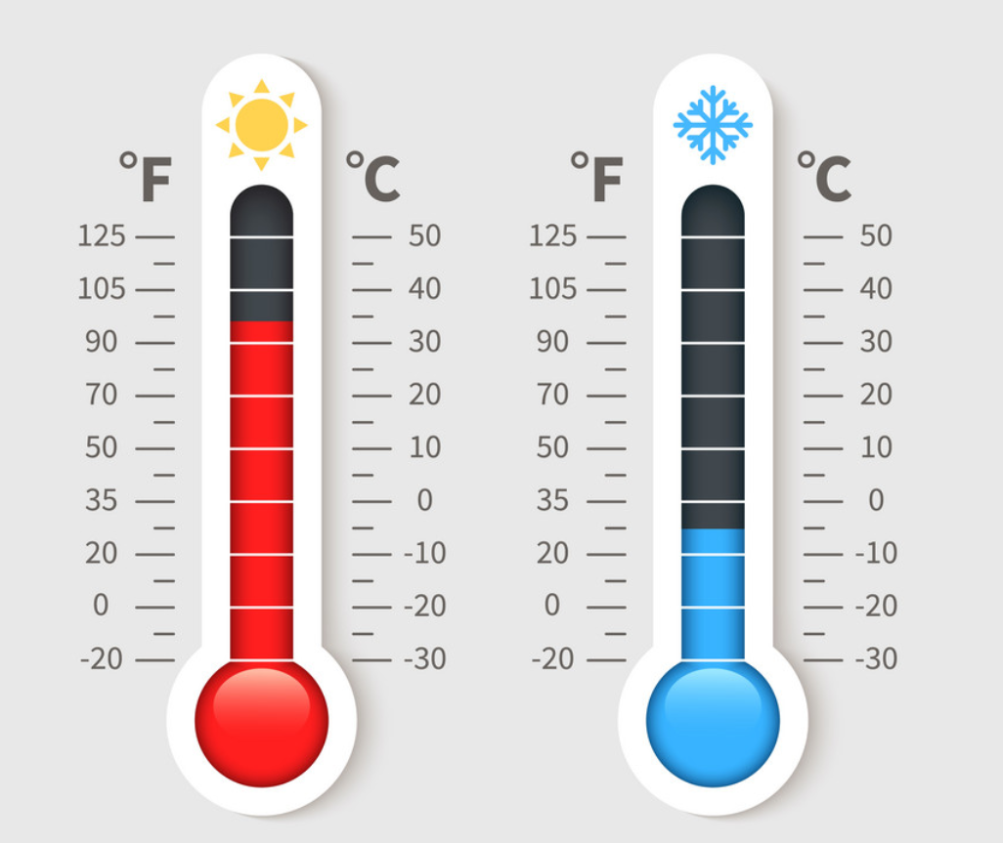



Exercise!
Build a program that can read 7 temperatures from the keyboard. Then it should calculate the average temperature and show which temperatures are above and below the average.

Slide 12
import java.util.*;
public class ArrayOfTemperatures {
public static void main(String[] args) throws Exception {
double[] temperatures = new double[7]; Scanner keyboard = new Scanner(System.in);
System.out.println("Enter 7 temperatures");
double sum = 0; for(int i=0; i<temperatures.length; i++){
temperatures[i] = keyboard.nextDouble();
sum = sum + temperatures[i];
}
double average = sum / 7;
System.out.println("The average is: " + average); System.out.println("The temperatures are:");
for(int i=0; i<temperatures.length; i++){
if (temperatures[i] > average){
System.out.println(temperatures[i] + " is above average.");
}
if (temperatures[i] < average){
System.out.println(temperatures[i] + " is below average.");
}
if (temperatures[i] == average){
System.out.println(temperatures[i] + " is the average.");
}
} keyboard.close();
}
}

Slide 13
Arreglos son objetos
Un arreglo es un objeto, por lo que cuando hacemos referencia a él en realidad estamos accediendo a una dirección de memoria que apunta a la lista de elementos.
Veamos el siguiente ejemplo:

Slide 14
double[] a;
10F50
a
null
10F51
Dirección de memoria en hexadecimal
10F52
10F53
Al inicializar la variable a,
se reserva una espacio para
almacenar una referencia
a un arreglo.

Slide 15
double[] a;
a = new double[5];
2C7F0
a[0]
0.0
a[1]
0.0
a[2]
0.0
10F50
a[3]
0.0
a
2C7F0
10F51
a[4]
0.0
10F52
10F53
Con la instrucción new
instanciamos un arreglo de
5 posiciones, en la dirección
2C7F0.

Slide 16
double[] a;
a = new double[5];
a[0] = Math.random();
a[1] = Math.random();
a[2] = Math.random();
a[3] = Math.random();
a[4] = Math.random();
2C7F0
a[0]
0.76
a[1]
0.16
a[2]
.99
10F50
a[3]
.15
a
2C7F0
10F51
a[4]
.03
10F52
10F53
Generamos valores para
cada elemento del arreglo.

Slide 17
Clave morse

Slide 18
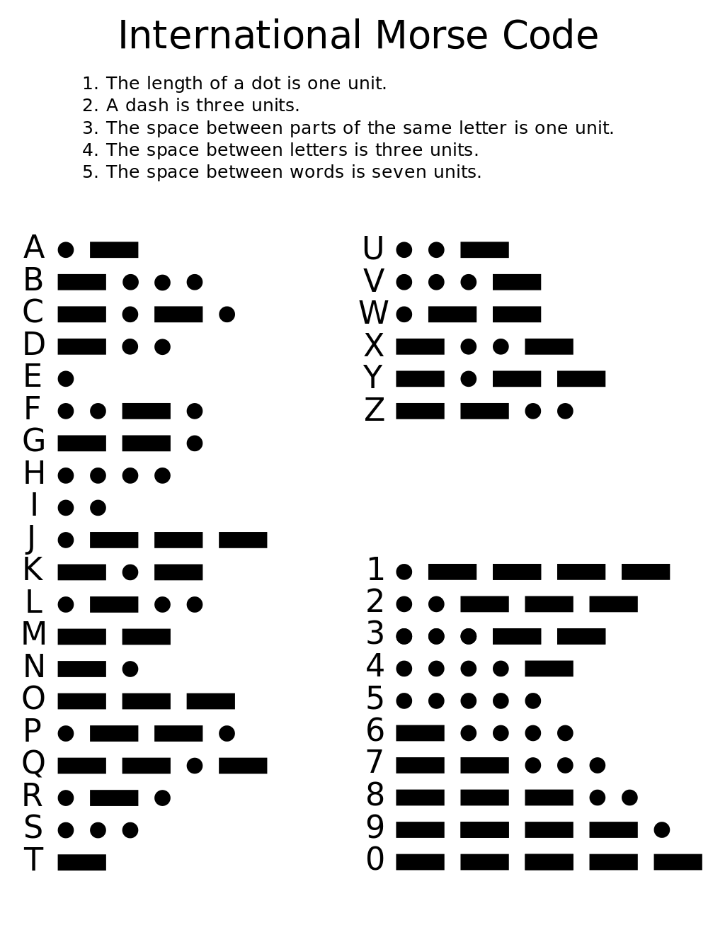

Slide 19
Diseña un programa que lea un número entero positivo del teclado, y lo convierta a clave morse.
Cada dígito distinto deberá estar separado por un espacio.
Por ejemplo:
El número 13, resultaría en:
.---- …--

